Slide 1

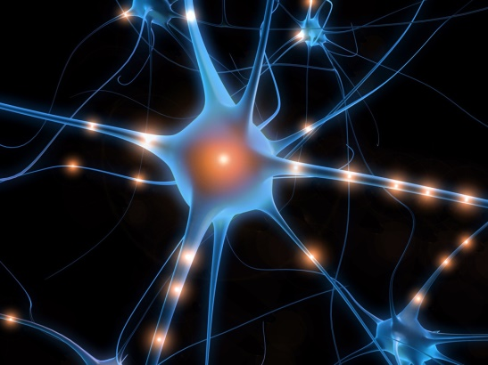
Cogmed Working Memory Training
‘Whoever you are, Cogmed training will challenge your brain – and improve it’
http://www.cogmed.com/how-it-works

Slide 2
‘implemented by healthcare professionals around the world’
combines ‘cognitive neuroscience with innovative computer game design’
‘cascading effect of improvements’
‘the most research-based intervention for improved attention’

Slide 3
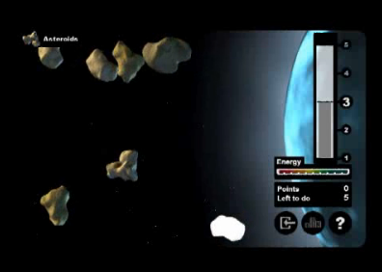
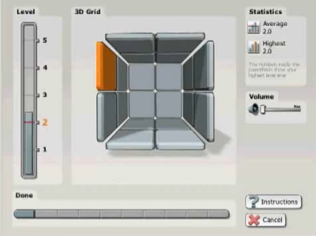
What is it?
Developed by Dr T. Klingberg
Computerised
Adaptive
25 sessions, each 30-45 mins
3 versions:
preschool – school age – adult
Visuo-spatial & Auditory Tasks
https://www.youtube.com/watch?v=JHqsyXgoJis

Slide 4
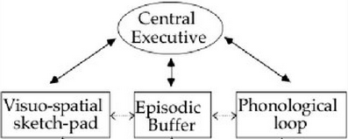
Working Memory
‘a brain system that provides temporary storage and manipulation of the information necessary for … complex cognitive tasks’
(Baddeley, 1992, p556)
Baddeley & Hitch, 1974

Slide 5

Working Memory
‘Working memory is the search engine of the mind’
‘Working memory is the cognitive function responsible for keeping information online, manipulating it, and using it in your thinking’.
(http://www.cogmed.com/
about-working-memory)

Slide 6
Link between WM & Learning
WM deficits thought to impinge the learning process
(e.g. Alloway, Gathercole, Adams and Willis, 2005)
WM thought to be one of best predictors of academic achievement, above IQ
(Alloway, 2009)
Cogmed: WM is the ‘engine for learning’
(http://www.cogmed.com)

Slide 7

Flexible/fixed capacity?
Limited capacity - was once a ‘defining characteristic of the model’
(Apter, 2012, referring to B & H model)
Fixed capacity but not fully developed until adolescence
(Gathercole, Pickering, Ambridge and Wearing, 2004)
Flexible and can increase through training
(e.g. Chein & Morrison, 2010)

Slide 8
Neuroplasticity
→ the ‘idea that an individual’s brain can reorganise itself and change,’
(http://www.cogmed.com /neuroplasticity).
‘Working memory capacity determines your cognitive performance. Cogmed training improves your working memory. Your strengthened working memory allows you to perform better. The training creates the cognitive foundation you need to prepare for success’.
(http://www.cogmed.com/how-it-works)

Slide 9
Neuroplasticity cont…
Klingberg did the initial research that showed it was possible to actually improve one’s working memory capacity through systematic, intensive training…
Increased scores on WM tasks = increased
WM capacity (?)
‘Physical-energetic model’
(Melby-Lurvag & Hulme, 2013, referring to
Cogmed theory)

Slide 10

What does the research say?
Effective short-term intervention for WM on tasks very similar to those trained…

Slide 11

But…
‘how enduring and generalisable the treatment effects from Cogmed training are remains to be demonstrated’
(Roche & Johnson, 2014, p381)

Slide 12
Generalisability of effects
Focus
Initiative
Reading Comprehension
Maths
Social
skills
Reduced
ADHD
Academic Progress
Planning
Confidence

Slide 13
Near transfer – similar WM tasks
Far transfer – different skills & abilities

Slide 14
Gropper, Gotlieb, Kronitz & Tannock (2014)
62 college students
ADHD / learning difficulties
5 weeks Cogmed training
standardised tests of auditory-verbal and visuo-spatial WM
Academic tasks & behavioural rating scales (self-report)
Measured pre-Cogmed, 3 weeks later & 2 months later

Slide 15
Gropper, Gotlieb, Kronitz & Tannock (2014)
→ significantly greater improvements on WM measures
→lower rates of ADHD symptoms and cognitive failures

Slide 16
Chacko et al (2013)
85 children 7-11 years
ADHD
Cogmed training vs placebo control group
WM tasks
Parental & Teacher ratings of attention, impulsivity & academic achievement
Pre-training & 3 weeks later

Slide 17
Chacko et al (2013)
Participants demonstrated greater gains on WM tasks
NO DIFFERENCES in parental & teacher ratings of attention, impulsivity & academic achievement

Slide 18
Melby-Lurvag and Hulme (2013)
No evidence that ‘training produces generalised gains to the other skills that have been investigated (verbal ability, word decoding, or arithmetic),’

Slide 19
Maintenance of effects
‘computer-based solution for attention problems caused by poor working memory’
(http://www.cogmed.com/program)

Slide 20
Holmes, Gathercole & Dunning (2009)
22 children, 8-11 years
Low WM scores (AWMA)
Cogmed adaptive training
Assessments: AWMA, instructional task, Wechsler Abbreviated Scales of Intelligence
Pre-intervention, 1 week later & 6 months later

Slide 21
Holmes, Gathercole & Dunning (2009)
→Significant gains in WM scores (greater for adaptive training ps)
Remained significant at 6 months
Significant gains in mathematical reasoning for adaptive ps 6 months later (but not immediately after training)
No significant improvements at (6 months) in all other far transfer measures

Slide 22
Melby-Lurvag and Hulme (2013)
‘participants’ scores on all of these sorts of measures, including attentional control, arithmetic, and word decoding tests, were not significantly improved compared to the control groups after a delay’

Slide 23
Conclusions
Likely to be an effective short term, specific intervention
Transfer to other tasks & abilities unlikely
Maintenance over time also unlikely
EPs might take a sceptical stance; more focus on environmental and coping strategies to support poor WM

